Slide 1
Listening to My Body

Slide 2
Whole body listening is when you give each body part a specific job so you can focus and listen to the person speaking or activity you are completing.

Slide 3
A good whole body listener has - eyes forward - shoulders forward - still hands - listening ears - calm feet - a quiet mouth
Eyes forward
Listening ears
Quiet mouth
Shoulders forward
Still hands
Calm feet

Slide 4
Sometimes there are distractions and it is hard for my mind to focus. This is okay!

Slide 5
To help kids focus, sometimes moving our bodies helps get the wiggles out! If I feel like I need to move I can ask an adult if this is okay.
Of course!
Can I move my body?

Slide 6
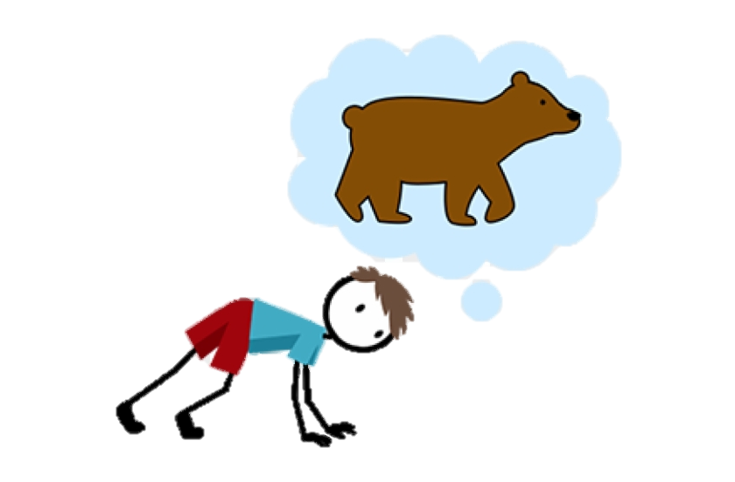
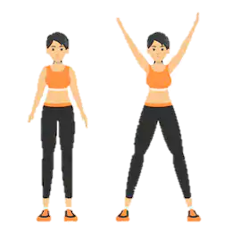
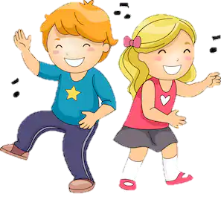
Jumping jacks, dancing, wall pushups, and bear crawls are just a few movement activities I could do!
Jumping Jacks
Bear Crawls
Dancing

Slide 7
When I am done moving, it is important to remember the keys to using whole body listening.
Eyes forward
Listening ears
Quiet mouth
Shoulders forward
Still hands
Calm feet

Slide 8
I will always do my best to use whole body listening.
I like using whole body listening!

